Slide 1


DSNES
NO-DUES MANAGEMENT SYSTEM
DEV SANSKRITI NO-DUES IN EASY STEP

Slide 2



Dev Sanskriti No-Dues in Easy Steps
PRESENTED BY:-
VIDHI GAUTAM

Slide 3

04
05
Requirement
Technology Used
03
06
Scope
ER Diagram
OUTLINE
02
08
Idea
Screen Shot
01
09
Introduction
Reference

Slide 4



DSNES
Students are supposed to get their no dues cleared from each department at the end of the degree or at any point in time they want to leave the college which is a very tedious and painstaking job.
Each Student has to go to every particular department to get their no-due to s form signed by the respective authorities of the department so that if there are any dues then they must be cleared.
INTRODUCTION

Slide 5


IDEA
Focus on developing a no-dues management system that will generate a computerized no-dues form showing the dues status.
To reduce the consumption of time usually taken during maintaining the records of the dues management.

Slide 6



SCOPE
EASY MAINTENANCE
TIME SAVING
NO-DUES IN EASY STEP

Slide 7

MINIMUM SOFTWARE REQUIREMENTS:-
1.Operating System:
Windows (Vista/Windows 7) or MAC OS
2.Web Brower:
Internet Explorer (8.0 and above)
Mozilla Firefox (3.0 and above)
Google Chrome
3.Third-Party Tool:
Microsoft Word

Slide 8
MINIMUM HARDWARE REQUIREMENTS:-
Processor - Pentium –III
RAM - 256 MB
Hard Disk - 20 GB
Key Board - Standard Windows Keyboard
Mouse - Two or Three Button Mouse
Monitor - SVGA

Slide 9





TECHNOLOGY USED
01
02
03
04
TOOLS:-
Text Editor as Notepad, Sublime Text, etc., XAMPP (Server)
FRONT END LANGUAGES:
HTML5, CSS3, JavaScript, BootStrap (framework)
PLATFORMS:
Internet Explorer (8.0 and above), Mozilla Firefox (3.0 and above), or Google Chrome
BACK END LANGUAGES:
PHP (Database) and MYSQL (Scripting Language)

Slide 10
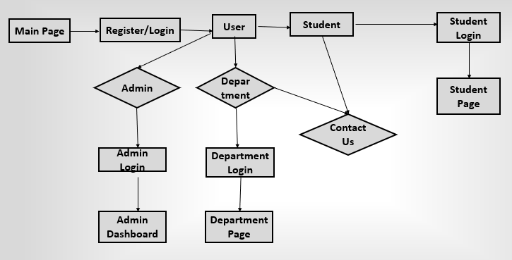
ERD DIAGRAM

Slide 11
SYSTEM DESIGN / SCREENSHOTS

Slide 12
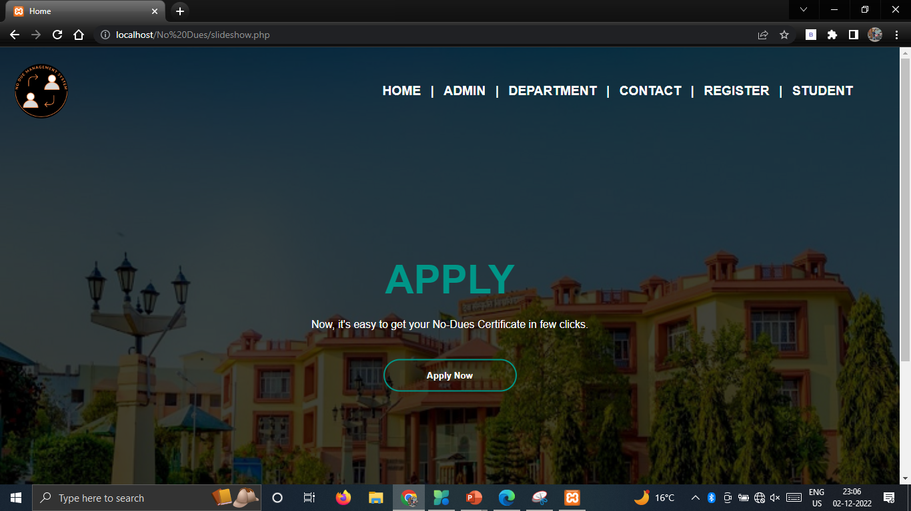
Dashboard

Slide 13
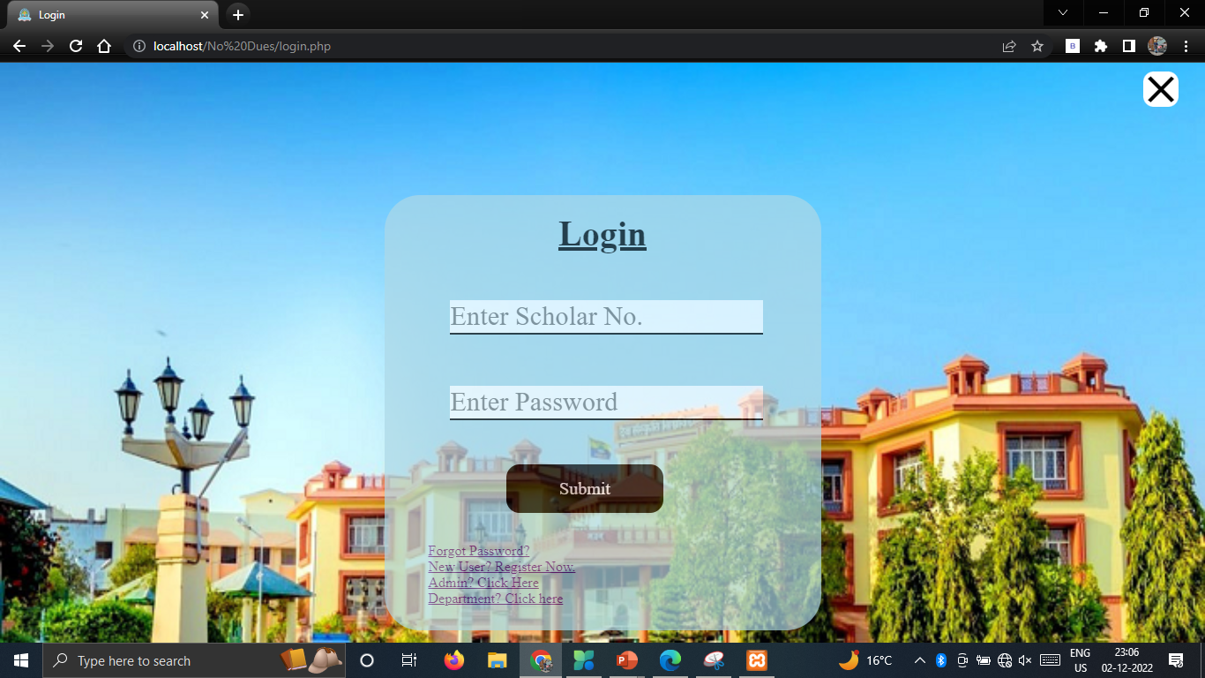
Student Login Page

Slide 14
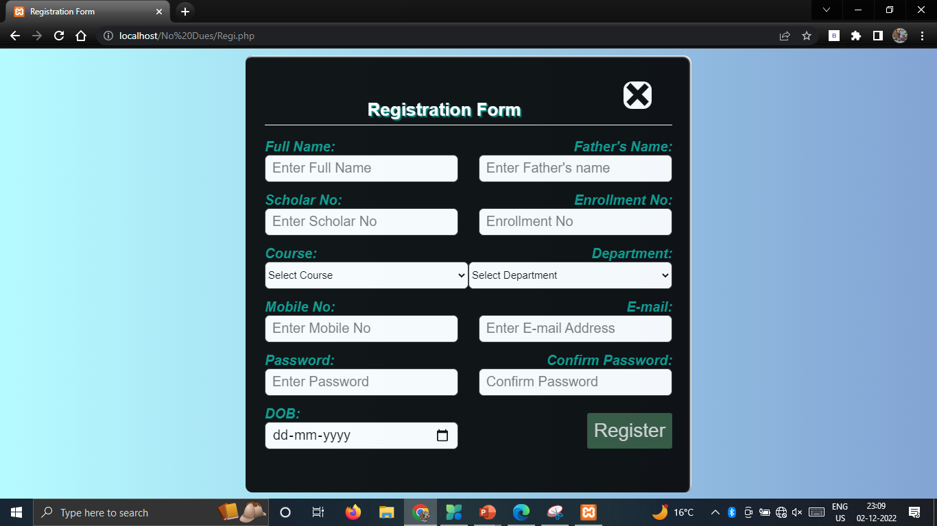
Student Registration Page

Slide 15
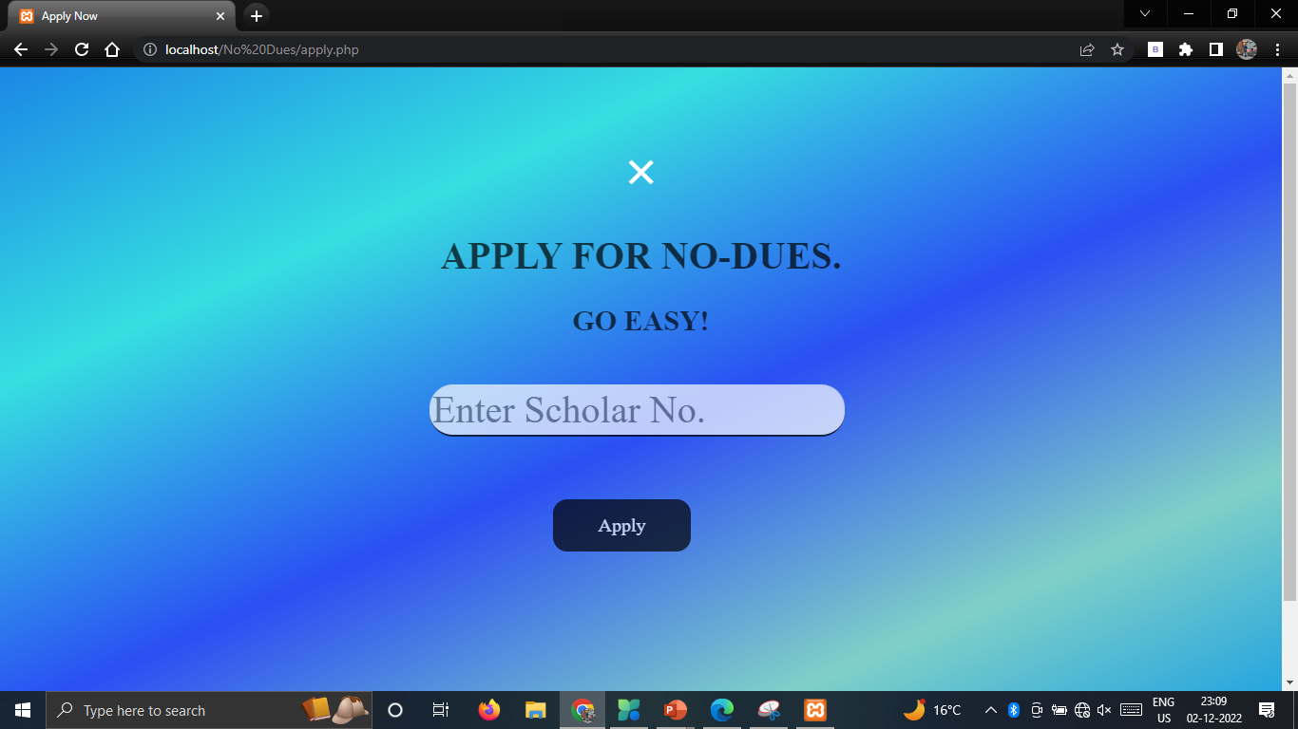
Apply Page

Slide 16
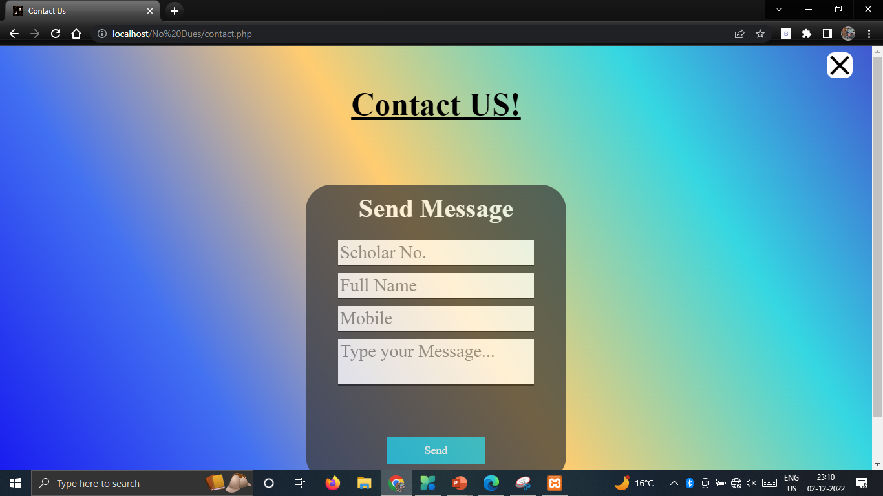
Contact Us Page

Slide 17
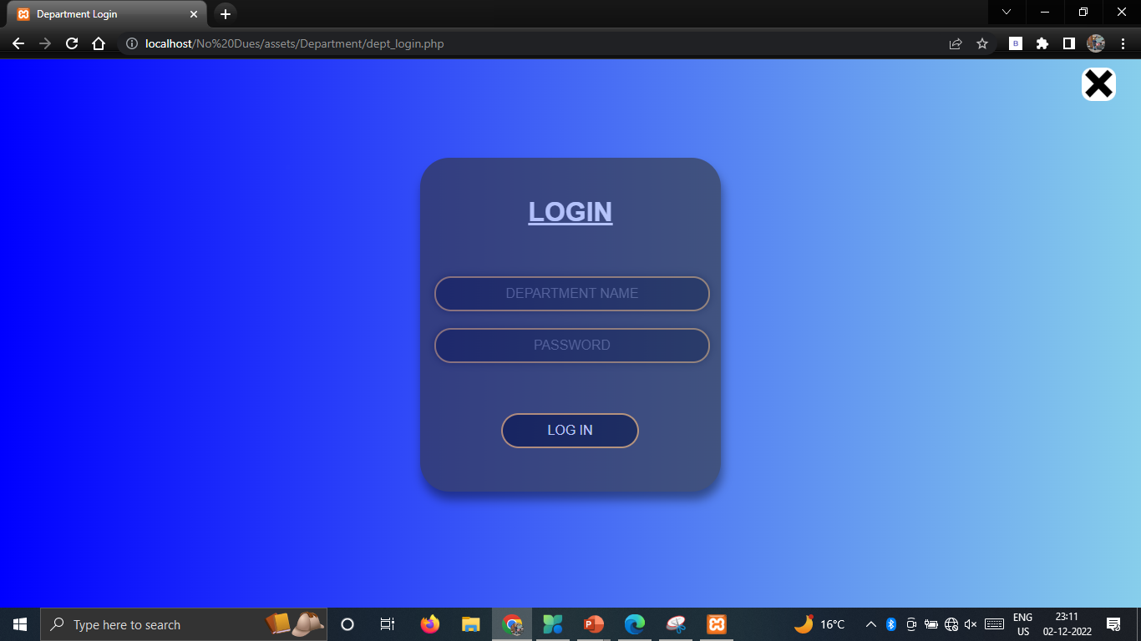
Department Login Page

Slide 18
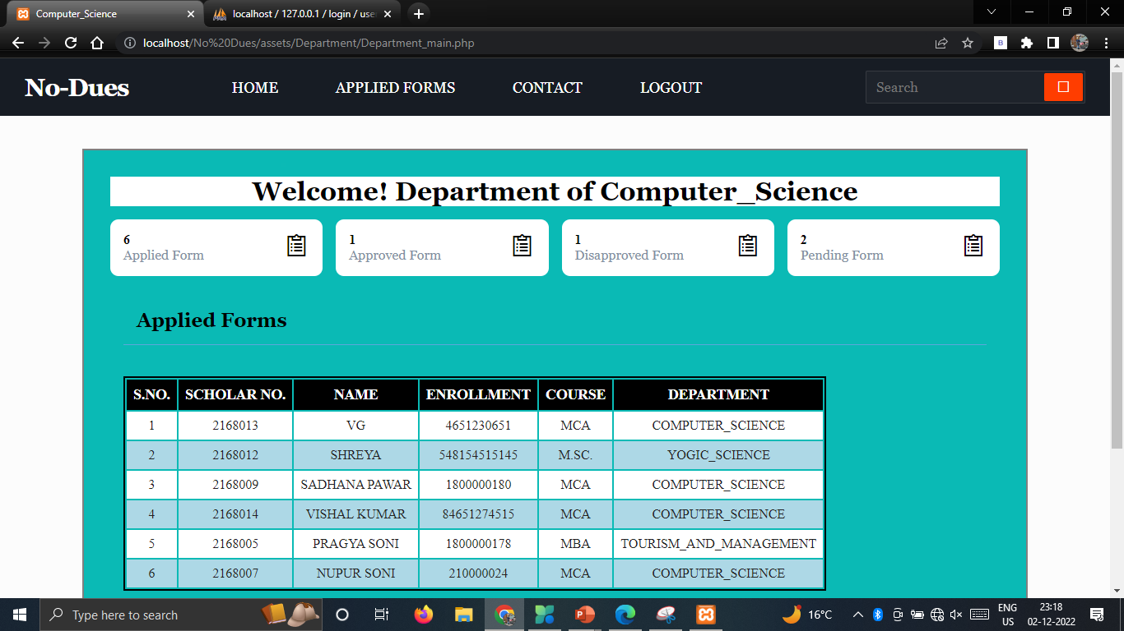
Department Dashboard

Slide 19
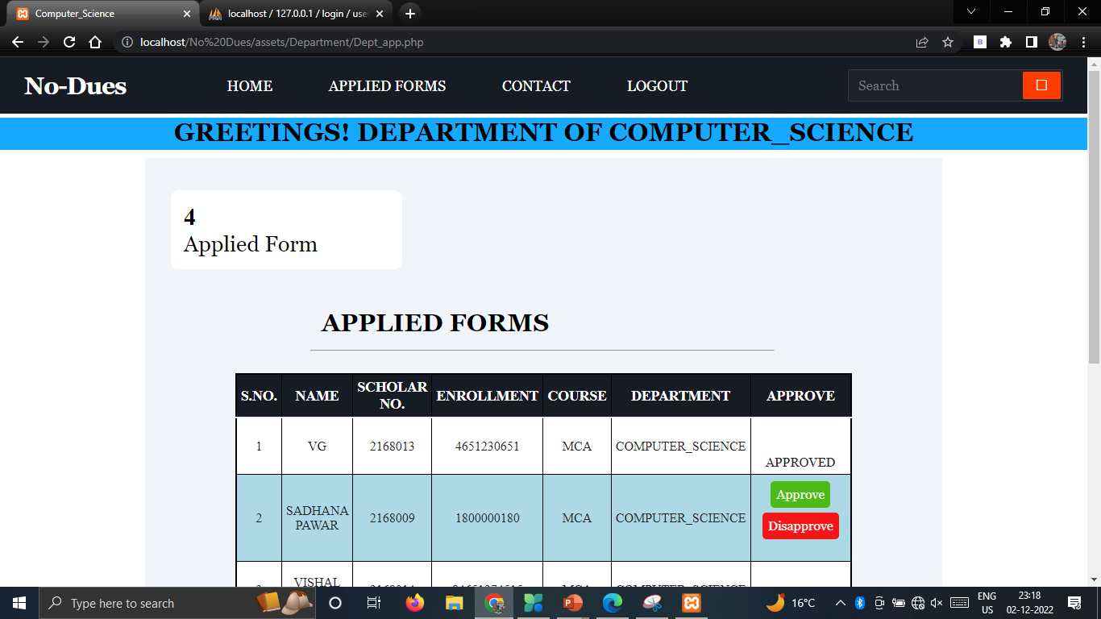
Department Approval Page

Slide 20
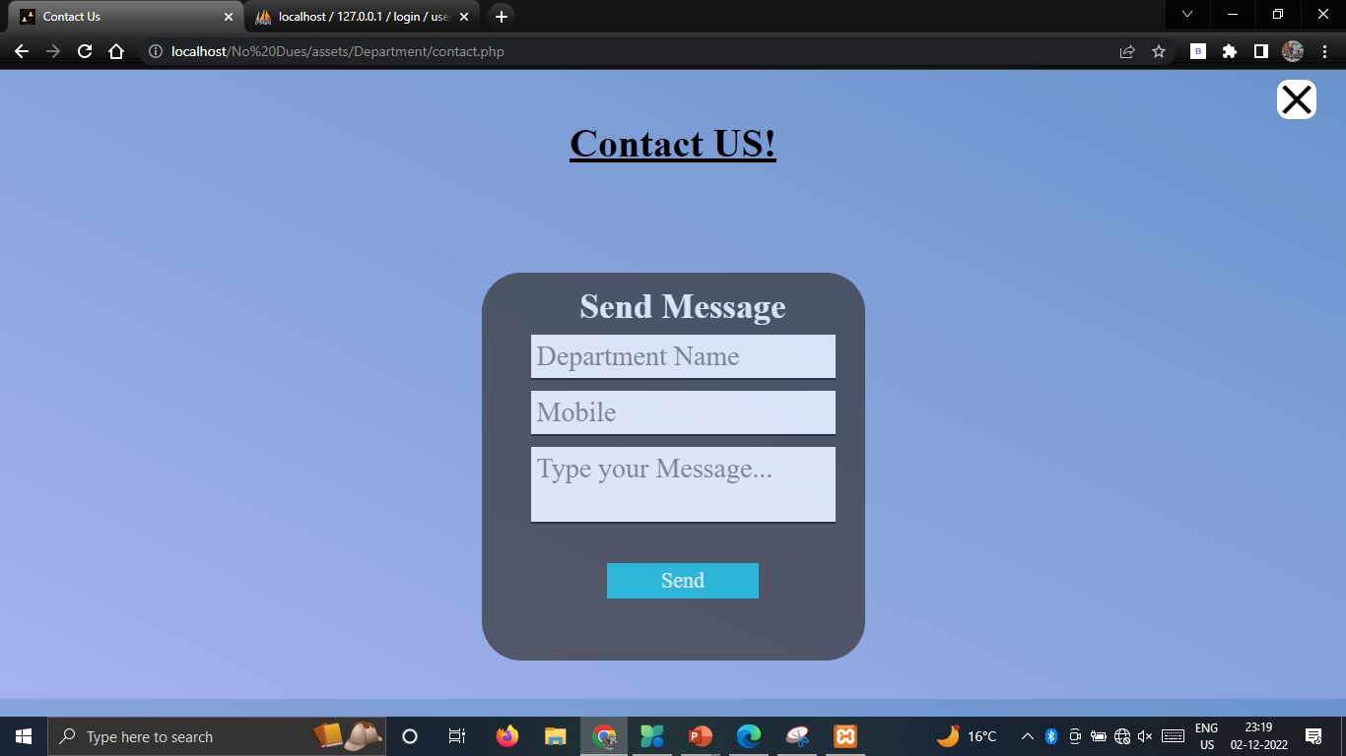
Department Contact Us Page

Slide 21
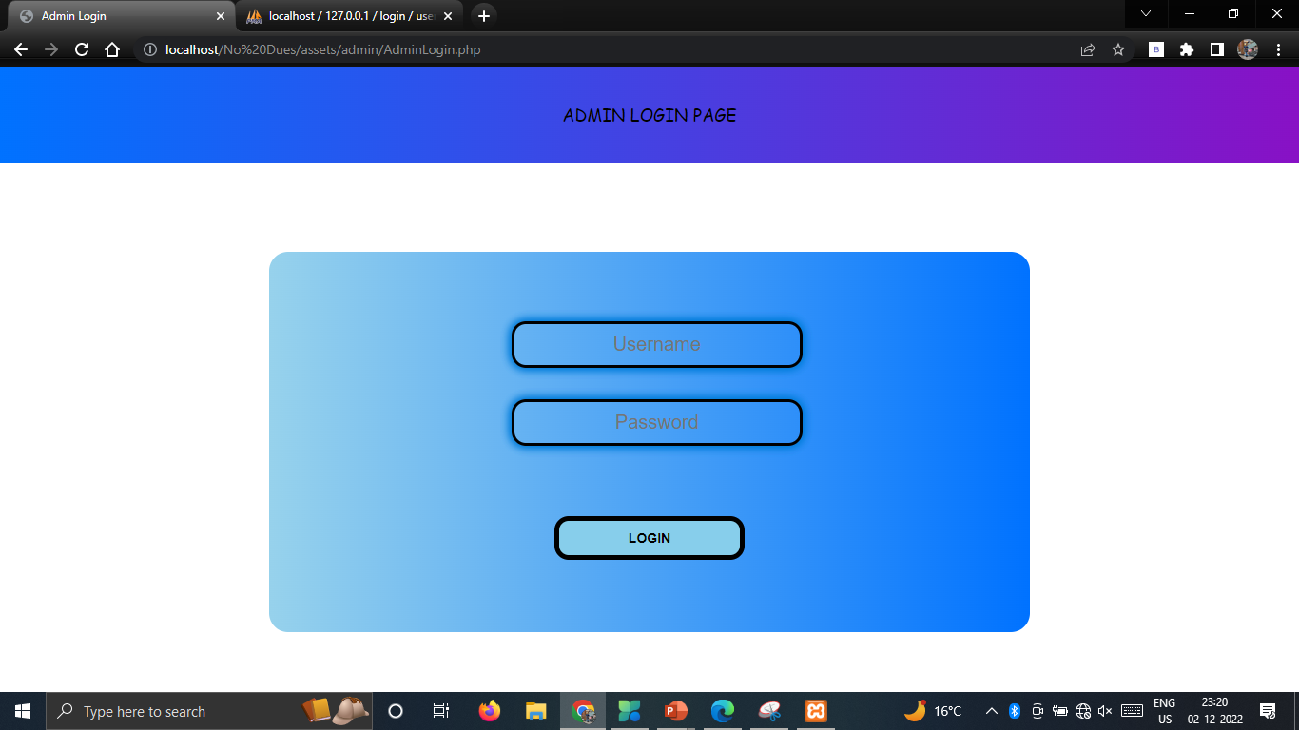
Admin Login Page

Slide 22
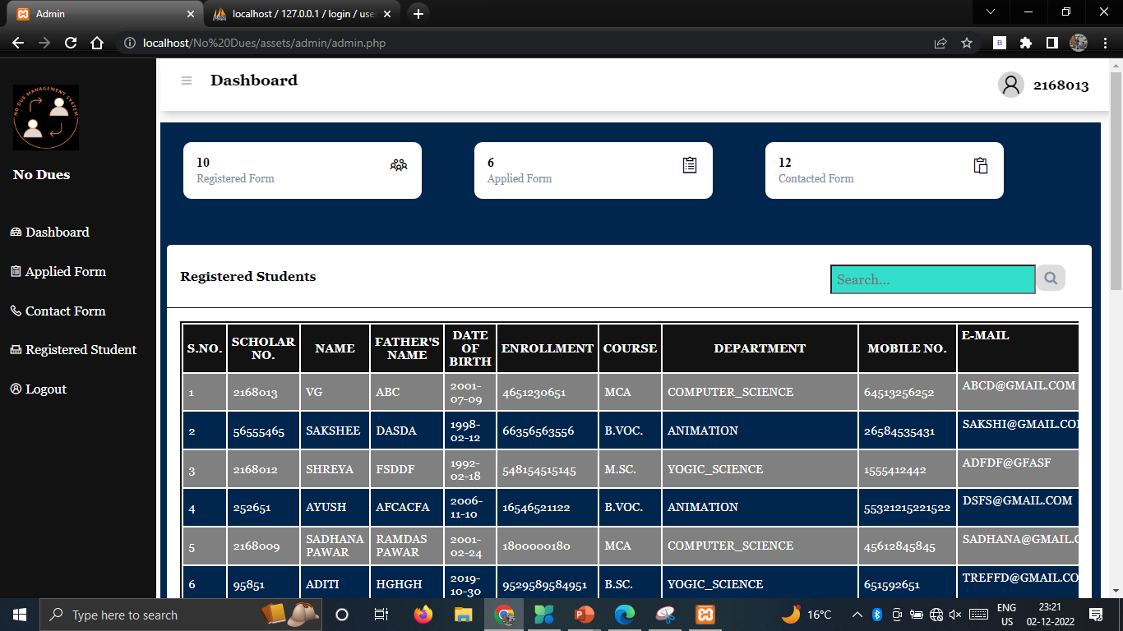
Admin - Dashboard

Slide 23
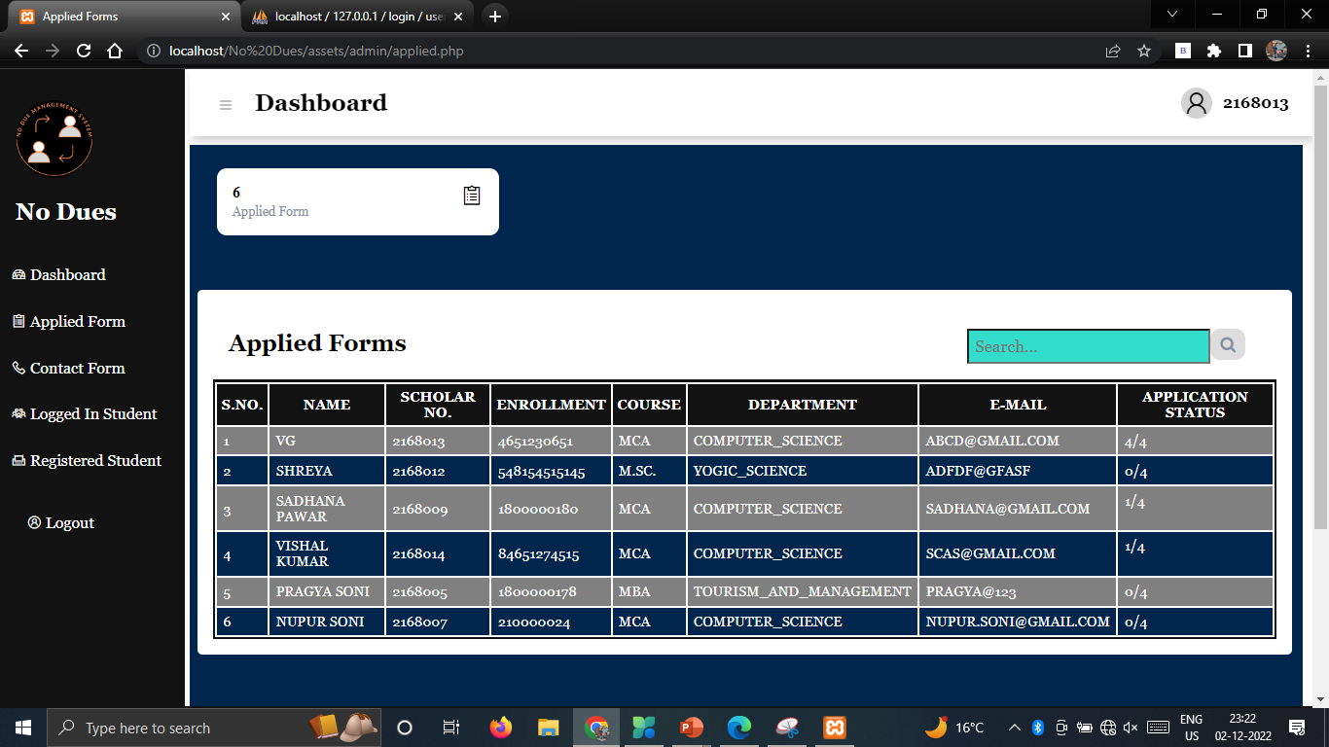
Admin – Applied Form Page

Slide 24
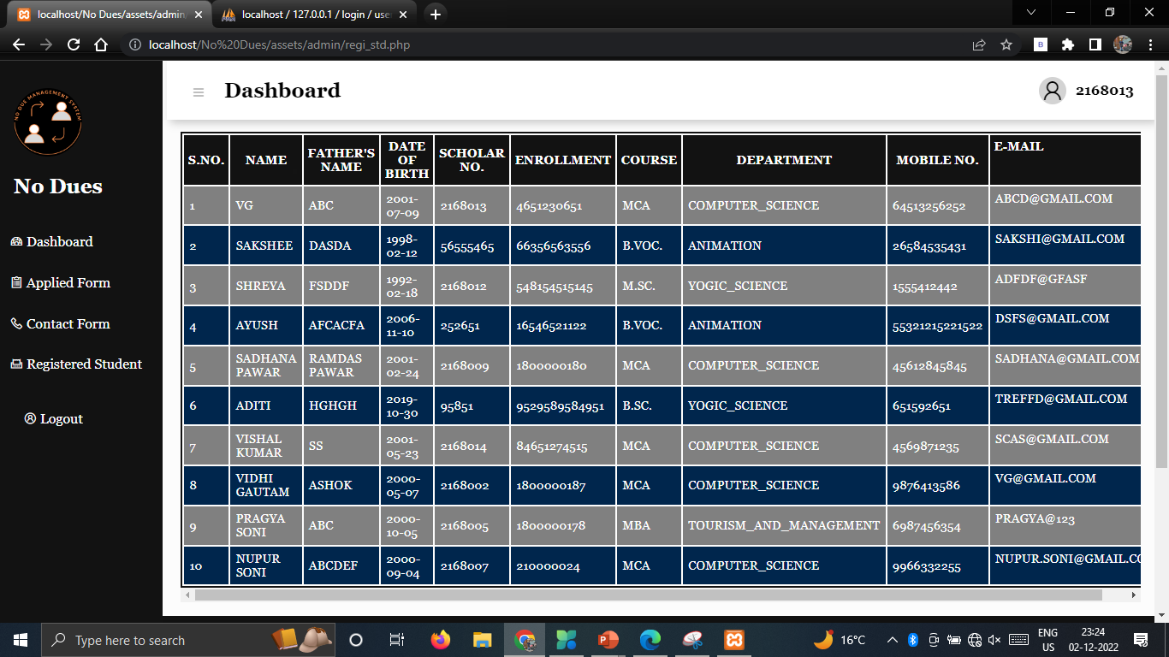
Admin – Registered Students

Slide 25
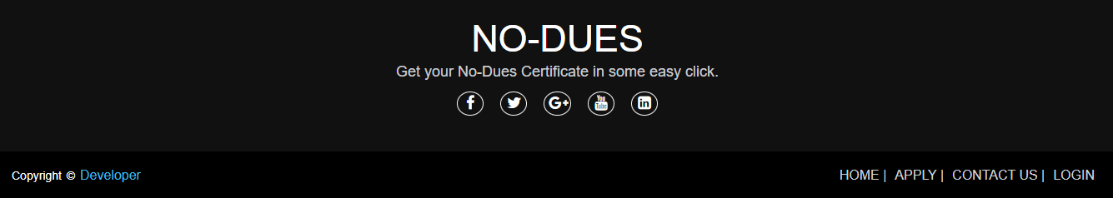
Footer

Slide 26
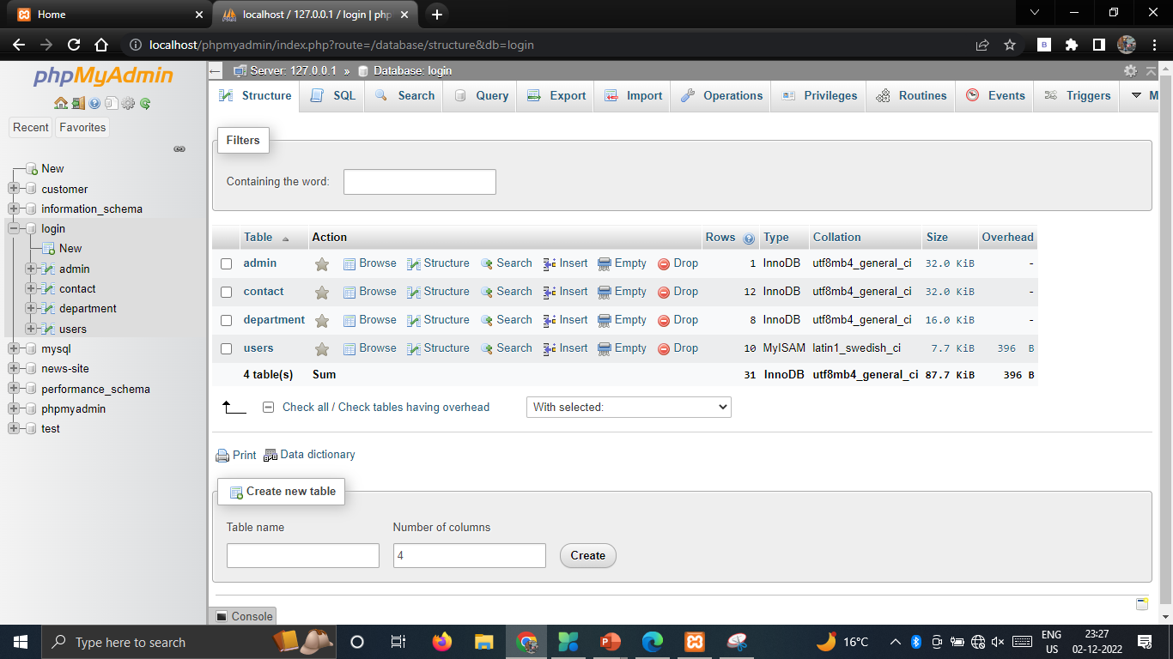
Database

Slide 27
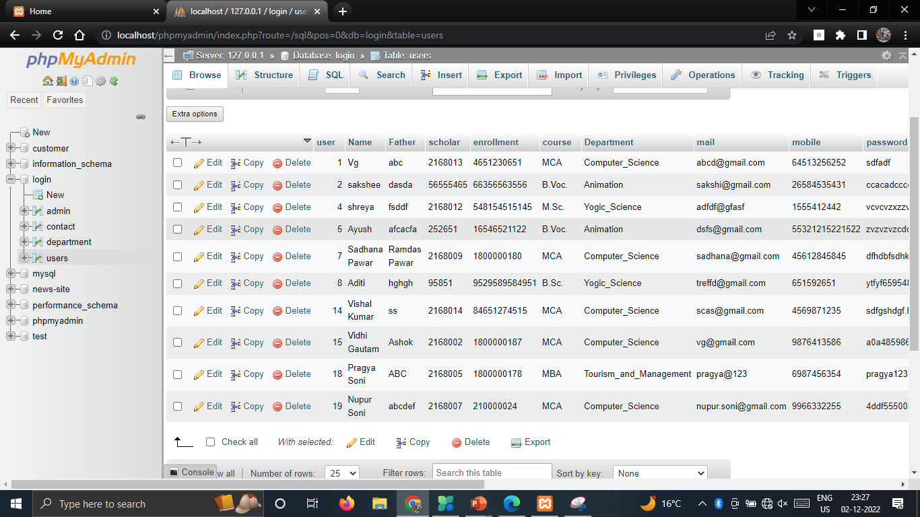
Database

Slide 28
REFERENCES
l www.youtube.com
l www.w3school.com
l www.javatpoint.com
l www.codeproject.com
l https://www.homecredit.co.in/
l https://www.tutorialspoint.com/mysql/mysql-introduction.htm
l https://m.yaantra.com/landingpages/mobile-phone-repair-service-center

Slide 29
THANK YOU…

